Slide 1
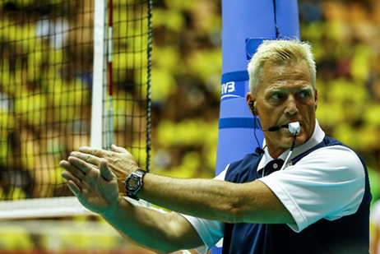
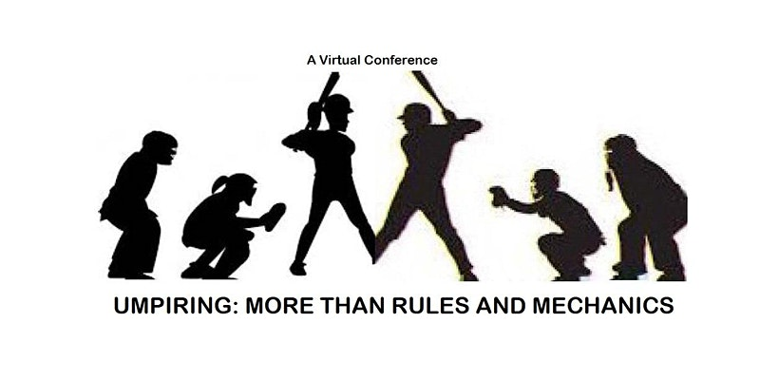
Psychology of Refereeing Scott McLean, PhD, BCFT, RSW International VB Referee
.
Umpiring: More Than Rules
and Mechanics
.

Slide 2
Managing Internal and External Pressure
The umpire’s role in the game should be act as an intermediary within the context rule execution and interpersonal relations.
This can also be referred to as ‘managing the pressure or mental training.’
Pressure (distress) is basically a product of the environment and our self-imposed experience based internally and/or externally.
There is a balance and/or optimum level of arousal and stress to maximum umpiring performance.
https://www.youtube.com/watch?v=8CA6Di3ix0k (1.48)

Slide 3
Human (sport) Performance

Slide 4
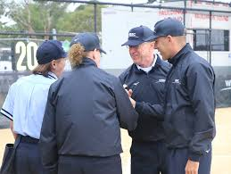
Achieving Optical Performance
Preparation
game film of teams
standings of league/teams
previous interactions
anticipated situations
review your own official journal [technical items as well as arousal-stress elements].
rule book and case book
practice of general-specific eye focus
practice of other skills such as hand signals, movement and voice commands
observe other umpires and officials in other sports
Energized
Focused

Slide 5
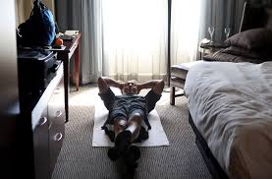
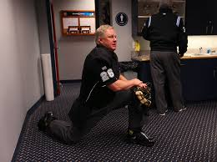
Achieving Optical Performance
Preparation
Energized
rest
nutrition and hydration [flavour of drink]
reducing personal ‘clutter’
pre-match discussions with colleagues [in the dressing room and visible to the participants on the field]
bodily functions
routine/ritual [habitual – effortless]
Focused

Slide 6
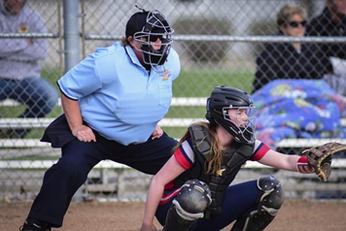
Preparation
Energized
Focused [in the ZONE]
physical (self-regulated) arousal
communication with colleagues
communication with participants
equipment check [possible checklist]
practice role (plate umpire – crouch, eye focus, side to side, hand signals; base umpires – side to side and front and back, eye focus).
visualization and relaxed breathing
routine/ritual
reflect on performance during [and after the game – official journal].

Slide 7
Emotion and Communication
The umpire’s role in the game should be act as an intermediary within the context rule execution and interpersonal relations.
Ongoing communication and conflictual moments in the game.
Sport is a game filled with emotions. It happens just too often that some participants go beyond the line and show signs of frustration.
However, there are times when the umpire needs to exhibit certain strengths (self-emotional control and ability to manage the emotions of others) so that the game does not get out of control.
Umpire needs to manage and resolve conflict and reduce confrontation.

Slide 8
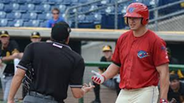
Umpire Actions
Emotions
Ongoing Communication
The role of the umpire is to stay in emotional control (breath) and maintain a physical presence (perception of confidence).
Word choices as the participant/coach discusses a situation or is in high emotion.
Anger/conflict is a secondary emotion … what is underlying the situation.
Informal discussions during the game with participants.
Informal visuals with participants interpersonally.
Formal discussions with the participants (interpersonal versus ‘in public’.)
Formal discussions and visuals in public.
https://www.youtube.com/watch?v=7xTwvfGckLo (1.00)

Slide 9
Pressure – a variety of characteristics
I Recognize the Symptoms of Being Under Pressure
II Reframe Pressure
III Reduce Internal Sources of Stress
IV Reduce External Sources of Stress
V Use pressure in game preparation (to mimic game conditions)

Slide 10
Pressure – a variety of characteristics
I Recognize the Symptoms of Being
Under Pressure
Pressure is a continuum, from minimal to immense.
As we move along this scale toward higher pressure, certain mental and physiological reactions start to happen: heart rate and breathing rate increase, blood pressure (higher body temperature), dry mouth and you might feel ‘butterflies in your stomach’.
Recognizing these symptoms is important, as it allows us to better control them. Additionally, it allows us to focus on ‘control the controllables’ within our ability.

Slide 11
Pressure – a variety of characteristics
II Reframe Pressure
If we perceive pressure as negative, we will associate it with negative thought processes such as self-doubt.
However, if we perceive pressure as positive, feeling its signs could improve our performance (confidence).
Umpires are known for either ‘blowing or excelling’ under extreme pressurized circumstances.
Positive/Confidence self-talk such as; “I am ready for this adventure.” “I deserve to be here.” “Wow this is awesome.” “I have been here before and have performed well.” “And a way we go.” “Focus”. “Re-focus.”

Slide 12
Pressure – a variety of characteristics
III Reduce Internal Sources of Stress (strategies)
Depending on our mental skills, genetic makeup, and experience, how we respond to this increased pressure will be different.
Visualization of our duties and specific calls (preparation)
Start of the game - find our ‘grove’ and ‘do our thing’ (routine); body and the mind into an effective state for performance
Positive self-talk
The use of Tic-Tacs/gum and have water nearby.
Breathing (inhale/exhale 2-2, 4-4, 6-6, 8-8 and repeat (focus on the seconds).
Force a smile (when appropriate) more direct non-verbal communication with the umpiring crew.
Hum music that stimulates positive emotions.
Approach the situation with a more ‘task-orientated’ perspective – by ‘staying present in the moment’, such as pitcher looks for signal, pitcher windup, throw.
Make every call the same – have it become habitually (routine) unless you are requiring to reset – more movement with signal or voice projection.

Slide 13
Pressure – a variety of characteristics
IV Reduce External Sources of Stress (strategies)
Pregame discussions/interactions with players and coaches – comfort and personalities.
Breathing focus before the match - mental preparedness (in the locker room and on the sport field – develop a routine).
During the match when you are becoming emotional (such as increased heart rate, dry mouth, distraction – take a bit longer and breath (inhale/exhale 4-4, 6-6, 8-8 and repeat (focus on the seconds)
Teamwork and collaboration between working crew (connect between innings)
Consider clues of the players (clenched fist), team losing 5 runs in a row, fans booing the team, and the coach (getting on and off the bench; vigorously pacing the dug-out).
Manage emotional/conflict of participants (practice communications and word choices)

Slide 14
Conflict Management Approaches
The conflict-management approach can happen with words as in a conversation, the use of a paralinguistics, hand signals, warnings (an important consideration is considering your level and then being consistent).
Umpires to manage conflict in a Respectful manner (other methods to manage informally before the formal cautions such as discussions or verbal warnings).
Be aware of body language.
Umpires do not ‘give sanctions’, rather the participant has earned them due to their misconduct and not managing emotions/conflict in a non-emotionally charged manner.
Sanctions for behaviour relate to a) managing two teams b) perception of the field; c) if a sense of embarrassment

Slide 15
Pressure – a variety of characteristics
V Use Pressure in Game Preparation (mimics match conditions)
This is the opportunity for us to gain perspectives and confidence in our ability (overall preparedness).
Umpire exhibition games and team scrummages.
Attend other sport events live and focus on the officials in terms of game management and their interactions/reactions to participants and perceived pressure situations.
Umpire journal.

Slide 16
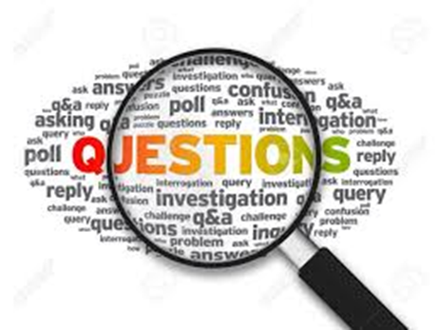
.
Open Discussion [specific situations or participants/umpire interactions]
Questions

